Slide 1
VR Plane Simulator
Jatin Singal

Slide 2
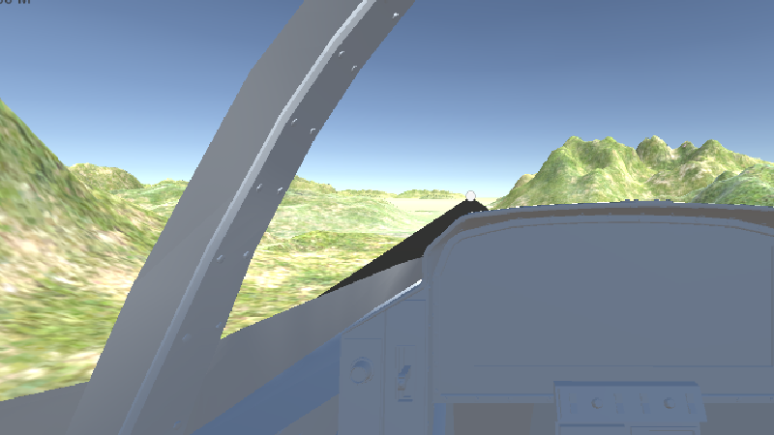
About the Game
This game gives us the first-player experience of flying a jet by combining VR and Plane flight games, which makes one feel as if they are inside the jet itself. Such games for VR cardboard are both amazing and fun to play.

Slide 3
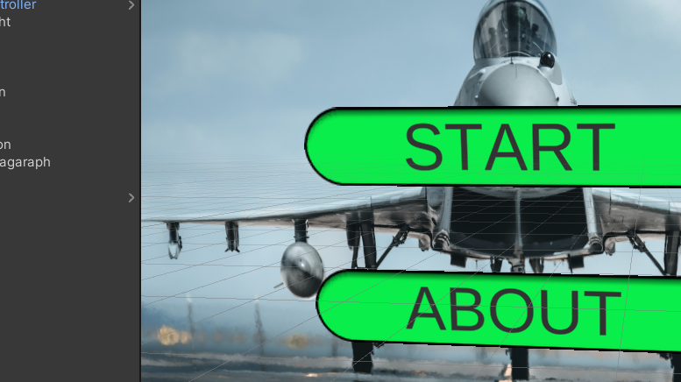
UI of the Game
Components of the UI Game:
Menu Canvas
Image
Main Section
Startbtn
Aboutbtn
About Section

Slide 4
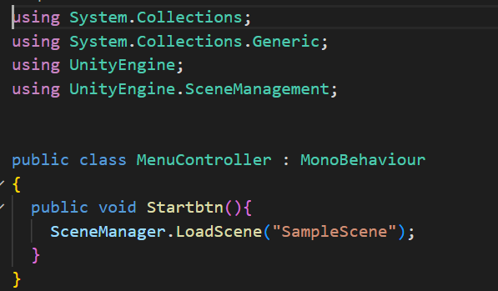
Functions of UI
The Main menu contains the script for controlling the Play and About buttons.
Start Button is used to switch scenes. From the main menu to SampleScene.
Further on, the AboutMenu contains the Back button which is used to Switch back to Main Menu.

Slide 5
VR Extension used:
Oculus XR Plugin
XR Interaction Toolkit
It gives all basic to adv tools for both AR and VR development of games like
Cross-platform XR controller input
Basic object hover, select and grab
Basic canvas UI interaction with the XR controller

Slide 6
Software Used
For the development of this app, the following software and SDKs are required:
Unity: Unity game engine is the most important software required for the development of this app as the whole app development will take place on this platform.
Unity editor extensions for PlayFab: It must start with PlayFab and its SDK for app development.
C# Scripts: For setting the behavior of game objects using code in c# language.
Visual Code Editor: This IDE is required for writing c# scripts.

Slide 7

Assists Used
FA-38 jet plane from unity asset store -----> plane model used in a game
Props for track environment ---> Road used as runway for plane.
Mountain Blend model ----> to represent the terrain in the environment of the game.

Slide 8
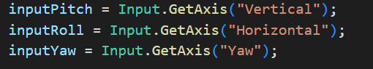
Control Inputs
I added some more controls in Unity control setup and also change the input buttons
Horizontal: For rotating clockwise or anticlockwise. Assigned to ( D and A, respectively).
Vertical: For lift and dip in air. Assigned to ( S and W, respectively).
Yaw: For left and right turns. Assigned to ( Q and E, respectively.)

Slide 9
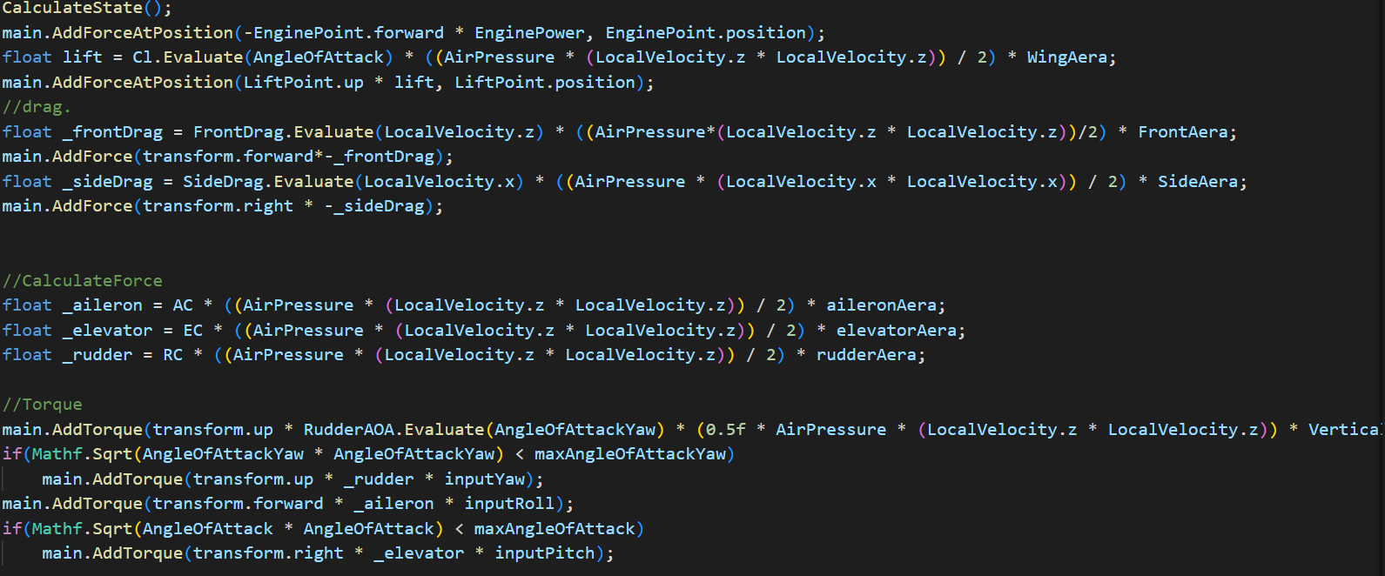
Script
AddForce function for applying thrust force causing lift and dip
Add Torque is function for applying torque causing rotation
AddForceAtPosition apply force at a particular position
Rest there is various updation in different variables like lift , _sidedrag.

Slide 10
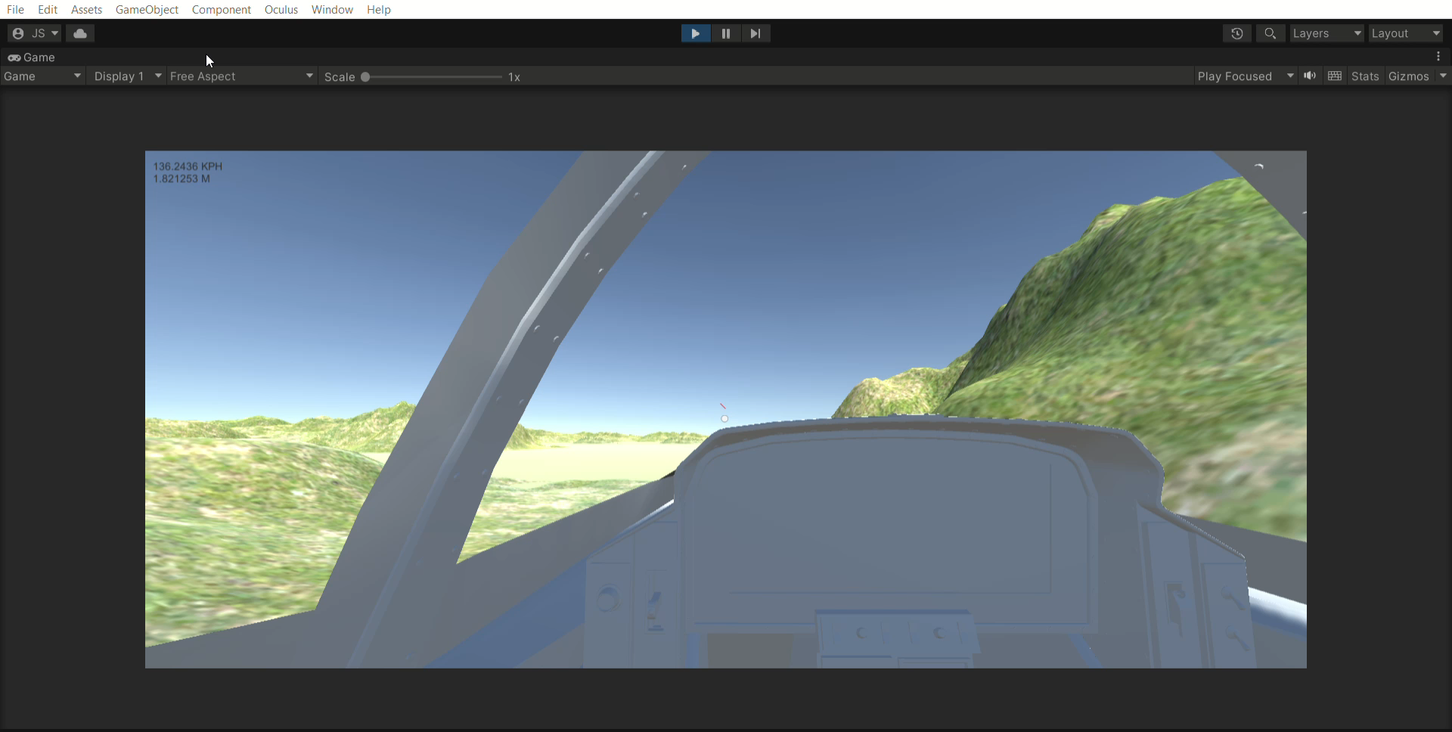
RESULT we get is :-

